Slide 1
IMAGE TO IMAGE TRANSALATION USING CONDITIONAL GAN
BY:GAYATHRI
REG NO:950021104013

Slide 2
AGENDA
1.problem statement
2.project overview
3.Who are the endusers
4.solution and its value proportion
5.Modelling
6.Dataset & sourcecode
6.Result
7.conclusion

Slide 3
PROBLEM STATEMENT
Image-to-image translation is a field within computer vision and machine learning aimed at converting images from one domain to another while preserving relevant semantic information. This task has various applications ranging from style transfer, colorization, image enhancement, to domain adaptation.
To build and train a model to mapping from input images to output images, as described in [Image-to-image translation with conditional adversarial networks.
It can be applied to a wide range of tasks, including synthesizing photos from label maps, generating colorized photos from black and white images, turning Google Maps photos into aerial images, and even transforming sketches into photos.

Slide 4
Project overview:
Goal: Train a model to translate images from one domain (source) to another (target) using conditional GANs (Pix2Pix).
Key Components:
Data: Paired image datasets (source & target image for each pair). (e.g., grayscale & color images)
Model:
Generator (U-Net): Creates new translated images, preserving spatial details.
Discriminator (PatchGAN): Analyzes small image patches for realism.
Loss Function: Guides training (adversarial & L1 loss).
Training: Iterative process to improve both generator and discriminator.
Evaluation: Assess model performance on unseen data (image quality, translation accuracy).

Slide 5
Who are the End Users
The end users of image-to-image translation:
Graphic Designers and Artists
Photographers
Content Creators
Researchers and Academics
Medical Professionals
E-commerce Platforms
Localization and Translation Services
Manufacturers and Engineers
Environmental Scientists:

Slide 6
Solution and its value proportion
Pix2Pix is a conditional Generative Adversarial Network (c GAN) architecture designed for image-to-image translation tasks. It was introduced by Isola et al. in their paper "Image-to-Image Translation with Conditional Adversarial Networks." Here's an overview of the solution for image-to-image translation using Pix2Pix:
1. Data Collection:
Gather a dataset of paired images. Each pair should consist of a source image from the domain you want to translate from and its corresponding target image in the desired domain.
2. Model Architecture:
Generator:
A U-Net architecture is commonly used for its effectiveness in image-to-image translation.
U-Nets employ skip connections that preserve spatial information during image processing, leading to sharper outputs
Discriminator:Unlike traditional GANs, Pix2Pix utilizes a PatchGAN discriminator.
This discriminator analyzes small patches of the image

Slide 7
Training: An iterative training process takes place: The generator creates a translated image from a source image and noise. The discriminator evaluates both the generated image and the real target image (from the dataset). Based on the discriminator's feedback (loss values), the generator and discriminator are updated using optimizers to improve their performance. Evaluation: After training, assess the model's performance on a held-out test set (data not used for training). Additional Considerations: Hyperparameter tuning is crucial for optimal performance. Experiment with different learning rates, network architectures, and loss function weights to achieve the best results for your specific task.

Slide 8
Value Proposition:
High-Quality Image Translation
Preserves Semantic Information
Flexibility and Versatility
Easy Integration and Deployment
Reduced Data Dependency
Enhances Creativity and Productivity
Improves User Experience

Slide 9
Model of image to image translation using conditional gan
Generator Network:
The generator network takes an image from the source domain as input and generates a corresponding image in the target domain.
Discriminator Network:
The discriminator network distinguishes between real images from the target domain and fake images generated by the generator.
It is a convolutional neural network (CNN)
Conditional Adversarial Training:The Pix2Pix model is trained using a conditional GAN framework, where the generator is conditioned on the input image from the source domain.
Loss Functions:
The training objective of the Pix2Pix model typically includes multiple loss functions:
Adversarial loss
Pixel-wise loss.
Training Procedure:
The Pix2Pix model is trained using paired images from the source and target domains.
Deployment:
Once trained, the Pix2Pix model can be deployed for image-to-image translation tasks in real-world applications.

Slide 10
Dataset&source code:
1) dataset_name = "facades“
URL=f'http://efrosgans.eecs.berkeley.edu/pix2pix/datasets/{dataset_name}.tar.gz
2)source code:
https://colab.research.google.com/drive/1HWMwIf7-WJE0rPBU8FuZYDl6-9DO6U-W

Slide 11
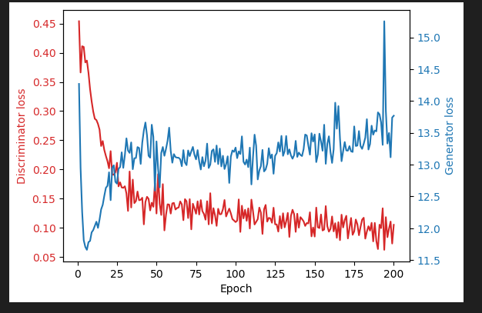
RESULT OF TRAINING DATASET:

Slide 12
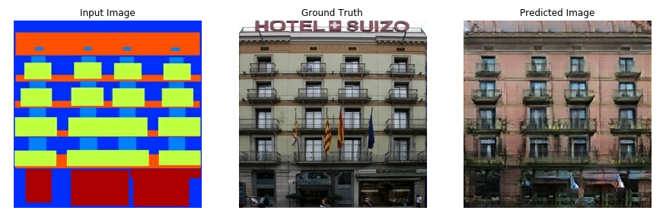
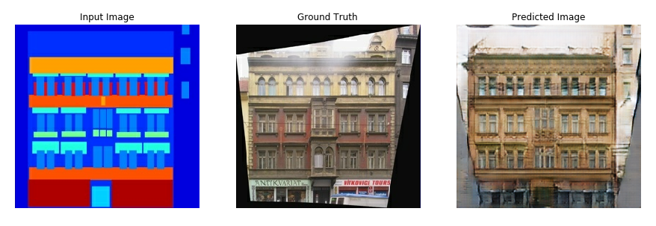
RESULT OF IMAGE TO IMAGE TRANSLATION

Slide 13
CONCLUSION:
Image-to-image translation leveraging Conditional Generative Adversarial Networks (GANs) has emerged as a powerful paradigm for various computer vision tasks. The ability of Conditional GANs to learn mappings between input and output domains without requiring paired training data has been demonstrated.
From pix2pix to more recent advancements like CycleGAN and UNIT, each approach has its strengths and limitations, underscoring the importance of selecting the appropriate model for the specific task at hand.
The impact of this technology extends across various domains including art, fashion, healthcare, and entertainment, among others.

